Slide 1
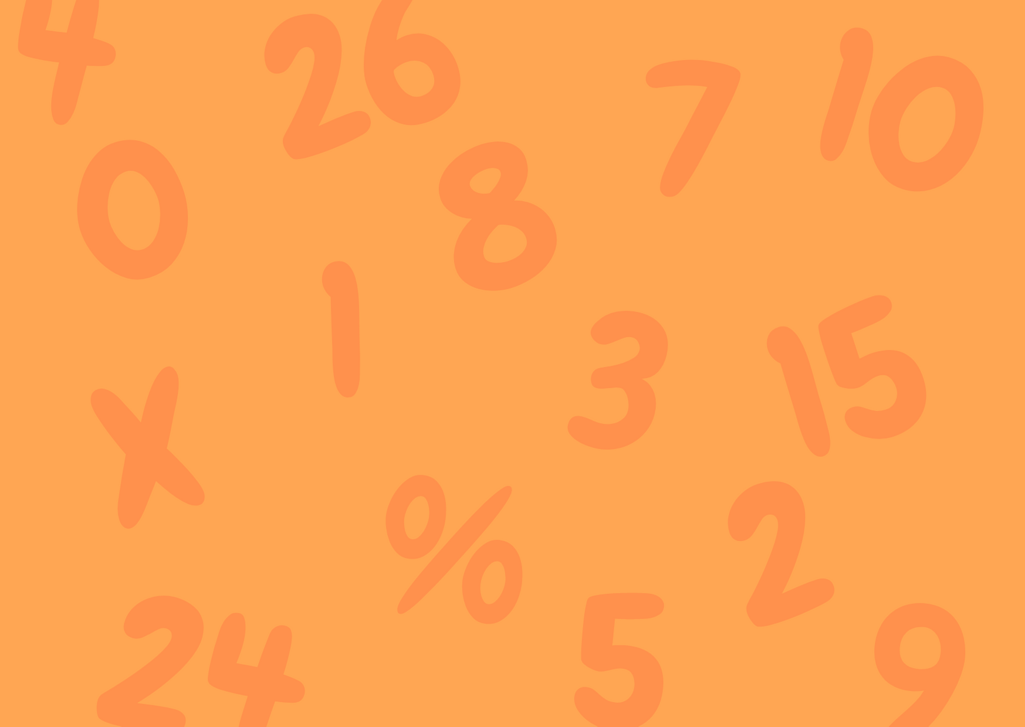

Slide 2
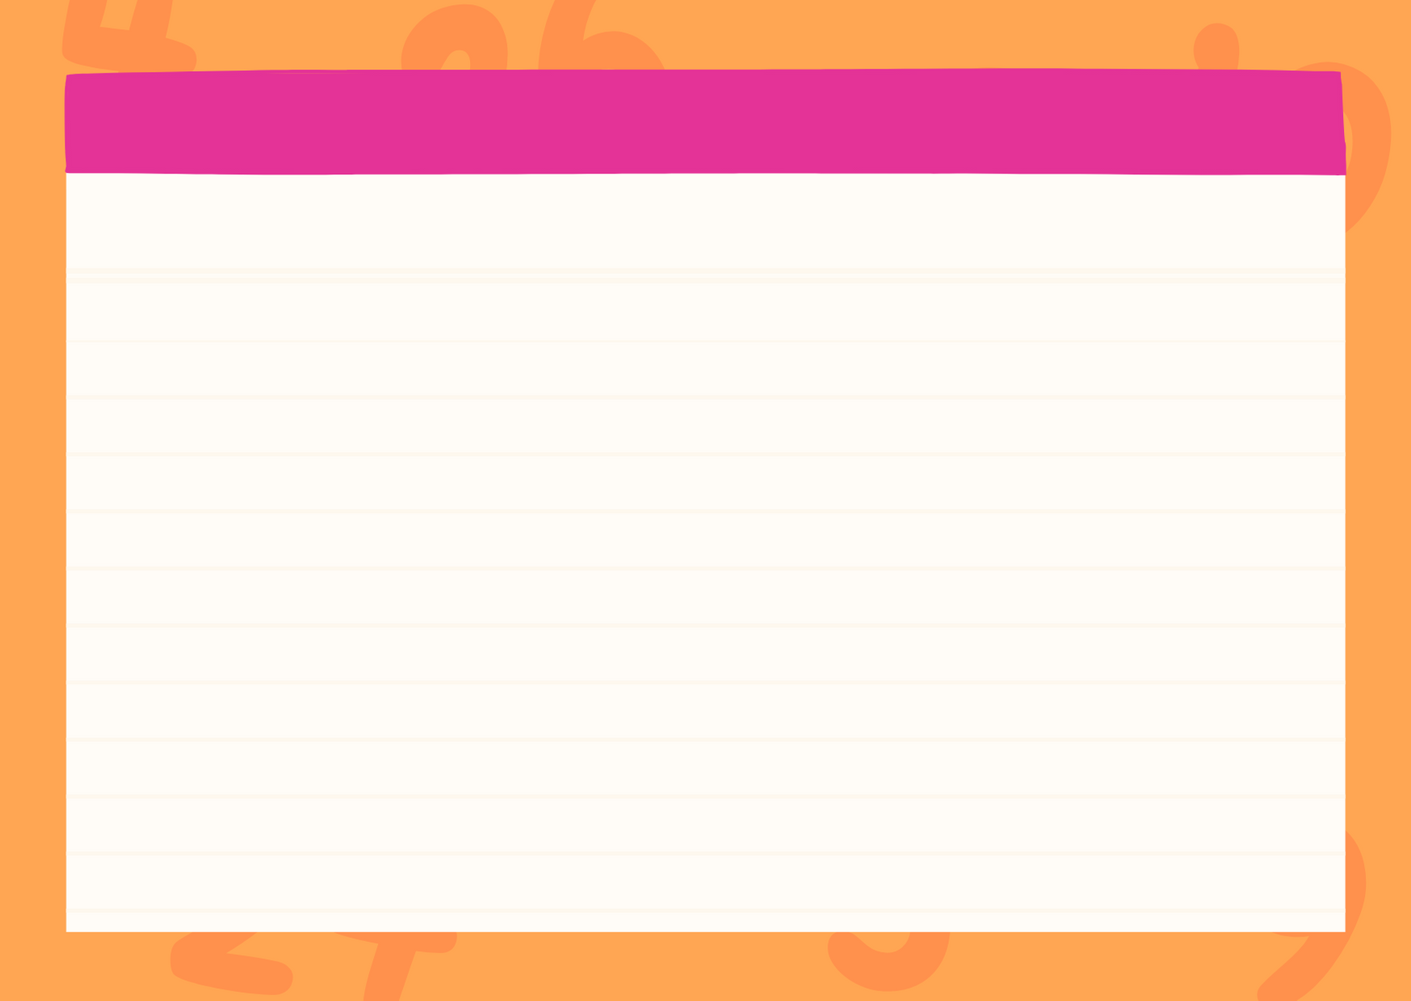
Print the cards and use them for learning and practicing Multiplication Math Terms! This can support your math class.
www.7GenerationGames.com

Slide 3
WWW.7GENERATIONGAMES.COM

Slide 4
Factor
Multiplying two whole numbers gives a product. The numbers that we multiply are the factors of the product.
5 x 2 = 10
Factors
www.7GenerationGames.com

Slide 5
WWW.7GENERATIONGAMES.COM

Slide 6
Product
The result of two or more numbers when multiplied together.
2 x 3 = 6
Product
www.7GenerationGames.com

Slide 7
WWW.7GENERATIONGAMES.COM

Slide 8
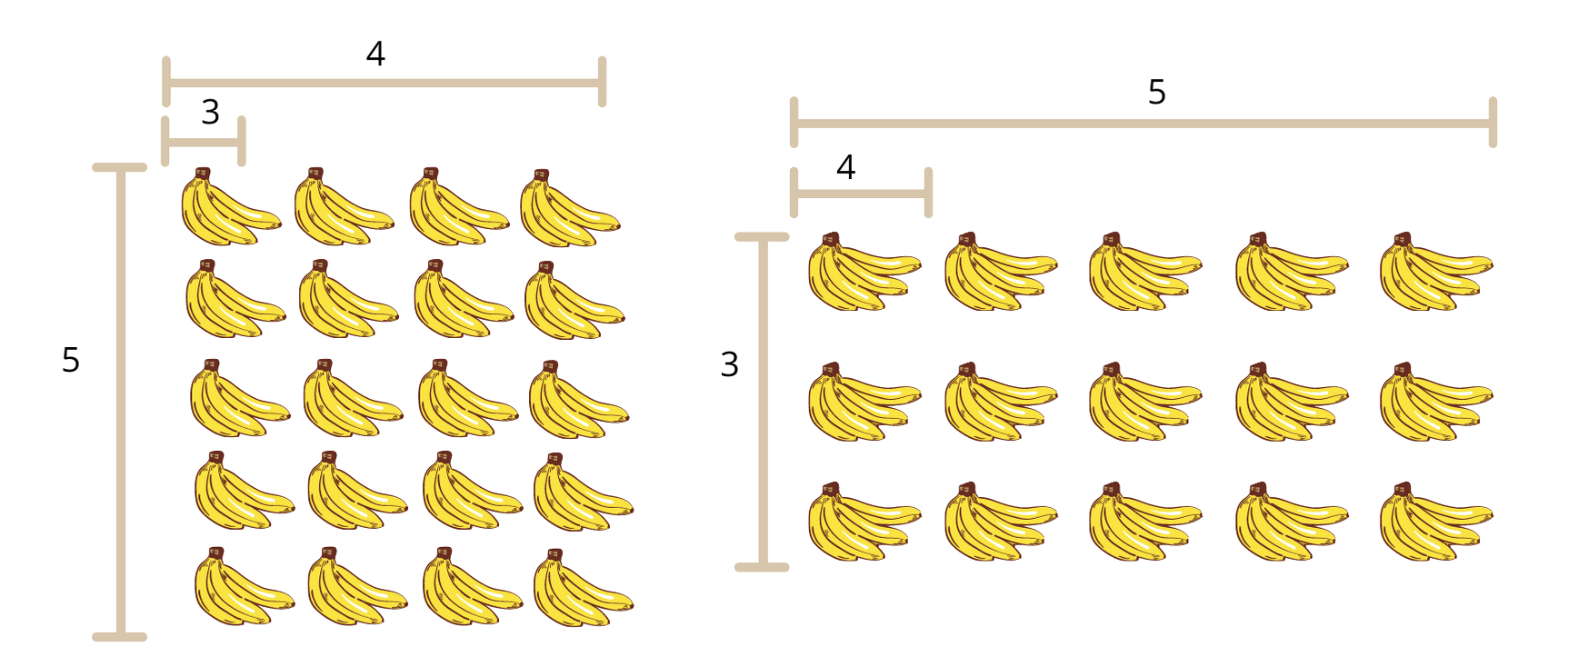
Associative property of multiplication
The product of three or more numbers stays the same no matter how the numbers are grouped.
( 3 x 4 ) x 5 = 60
3 x (4 x 5) = 60
www.7GenerationGames.com

Slide 9
WWW.7GENERATIONGAMES.COM

Slide 10
Commutative property of multiplication
Changing the order of the numbers in a multiplication problem, does not change the product (result).
2 x 5 x 10 x 6 = 5 x 6 x 10 x 2
600 = 600
www.7GenerationGames.com

Slide 11
WWW.7GENERATIONGAMES.COM

Slide 12
Distributive property of multiplication
Multiplying two numbers (factors) together gives the same answer as if you break up one factor into two numbers, multiply and add together the products
2 x 4 = 8
2 x (3 + 1) = 8
(2 x 3) + (2 x 1) = 8
www.7GenerationGames.com

Slide 13
WWW.7GENERATIONGAMES.COM

Slide 14
Identity property of multiplication
Any factor multiplied by 1 stays the same. Multiplying by 1 lets the factor keep its identity. But this doesn't apply when multiplying by 0
1 x 3 = 3
1 x 66 = 66
1 x 10,000 = 10,000
But, 1 x 0 = 0
www.7GenerationGames.com

Slide 15
WWW.7GENERATIONGAMES.COM

Slide 16
Zero property of multiplication
If you multiply any number by zero the answer will be 0
0 x 7 = 0
0 x 39 = 0
0 x 289 = 0
www.7GenerationGames.com

Slide 17
WWW.7GENERATIONGAMES.COM

Slide 18
Multiply by 10
When multiplying by 10, just add a zero to the end of the number.
5 x 10 is 5 with a 0 at the end, which becomes 50
4 x 10 =40
11 x 10 = 110
98 x 10 = 980
www.7GenerationGames.com

