Slide 1
Convert Rational Numbers to Decimals
Zeb Hammond

Slide 2
Convert Rational Numbers to Decimals
7th grade
Missouri Learning Standards (MLS)
7.NS.A.2.d

Slide 3
Convert Rational Numbers to Decimals
7th grade
Common Core State Standards
CCSS.MATH.CONTENT.7.NS.A.2.D

Slide 4
Objective
Apply and extend previous understandings of operations to add, subtract, multiply and divide rational numbers.
Apply and extend previous understanding of numbers to multiply and divide rational numbers.
D. Convert a rational number to a decimal

Slide 5
Key terms:
A terminating decimal is a decimal that ends. Examples: 0.8 0.75 0.1875
A repeating decimal is a decimal that has a digit or a group of digits that repeat over and over without ending. Examples: 0.33333333333…. or 0.27272727…..
A repetend is a digit or group of digits that repeat in a repeating decimal. A bar is placed over the repeating digit(s) as a shorthand representation.

Slide 6
Prior Knowledge Needed
Students will need to know how to read and write
Students will need to know how to set up a fraction
Students will need to know how to round to the thousandths place
Students will need to know how to multiply/divide and add/subtract

Slide 7
CHANGE ANY FRACTION TO A DECIMAL
Place numerator inside and denominator outside the house.
Add a decimal point and 3-4 zeros to the number in the house.
Bring the decimal point straight up (and forget about it!)
Follow the long division steps:
Dad ÷
Mom ×
Sister -
Brother ↓
5. Repeat step 4 until you get a remainder to repeat or a remainder of 0.
6. If the decimal is repeating, write a bar over the repeating pattern.

Slide 8
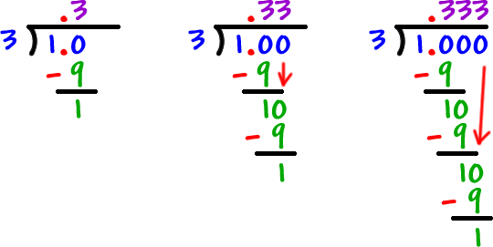
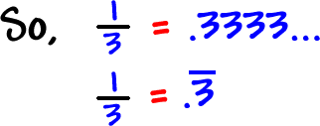
Let's look at an example!
Write 1/3 as a decimal.
Remember the numerator goes inside the house and the denominator goes on the outside.

Slide 9
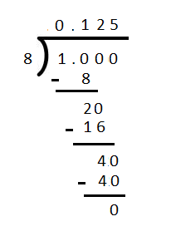
Let's look another example.
1/8

Slide 10
Now it’s your turn!
Micha has 3/4 oz of sugar to make her pie. The recipe calls for .80 oz. Does Micha have enough sugar?
PBL: Get into a group of 3 or 4 people.
Develop a recipe to feed the village elders (total of 12).
Select at least 3 recipes to modify for the number of people you’ll have to feed.

