Slide 1
Math Lesson Plan
Zeb Hammond June 4, 2020

Slide 2
Data Analysis, Statistics and and Probability
7th grade
Missouri Learning Standards (MLS)
7.DSP.C.5a

Slide 3
Data Analysis, Statistics and and Probability
7th grade
Common Core State Standards
CCSS.MATH.CONTENT.7.SP.A.1

Slide 4
Objective
DEVELOP, USE AND EVALUATE PROBABILITY MODELS.
Investigate the probability of chance events.
Determine probability of simple events.
Understand that the probability of a chance event is a number between 0 and 1 that expresses the likelihood of the event occurring.

Slide 5
Key terms:
Probability is the branch of mathematics concerning numerical descriptions of how likely an event is to occur or how likely it is that a proposition is true.
Probability is a number between 0 and 1, where, roughly speaking 0 indicates imposibily and 1 indicates certainty.

Slide 6
Materials
1 basket
1 apple
3 pears
4 peaches
8 persimmons

Slide 7
Prior Knowledge Needed
Students will need to know how to read and write
Students will need to be able to identify and distinguish the different fruits used in this lesson (apple, peach, pear, persimmon)
Students will need to know how to set up a fraction
Students will need to know how to round to the thousandths place

Slide 8
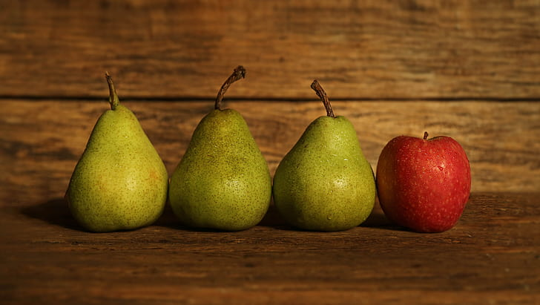
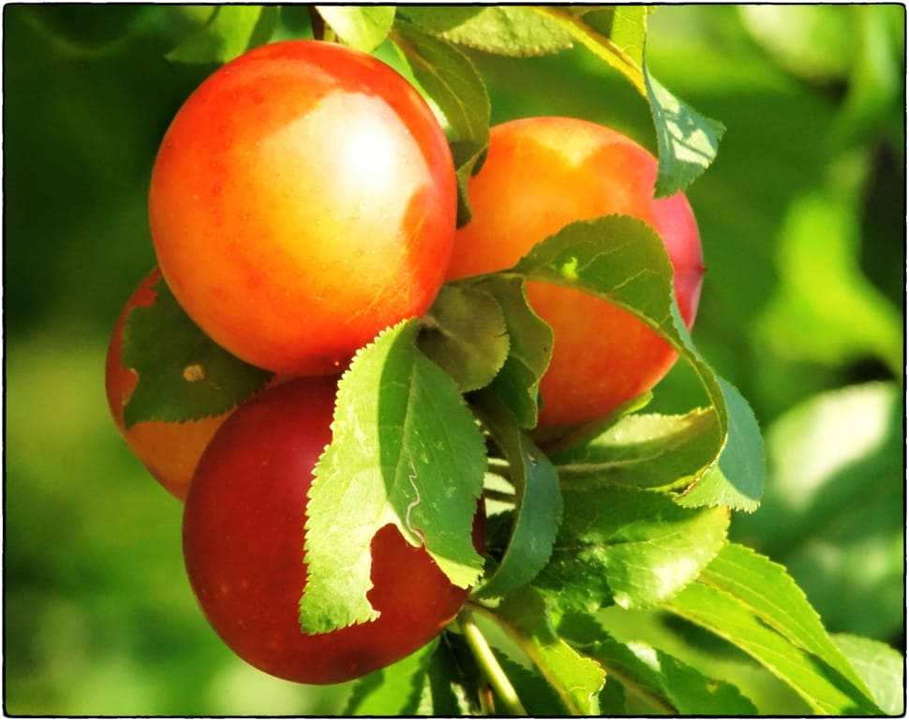
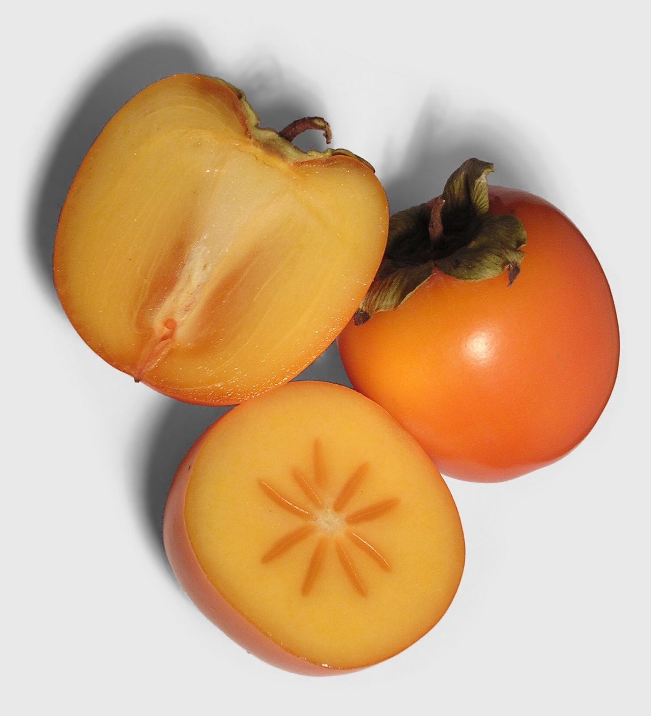
After a long hike through the woods, Sean gathered many types of fruits in his basket, including 1 apple, 3 pears, 4 peaches, and 8 persimmons. When he returned home, Sean wanted to show his father what was in his basket.

Slide 9
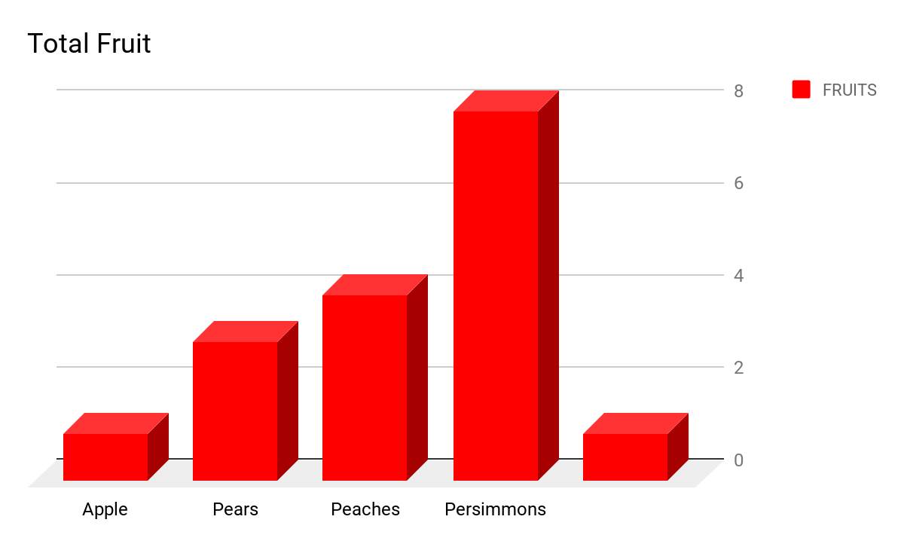

Slide 10
Let's look at probability of grabbing an APPLE out of the basket.
First-How many APPLES are in the basket? ( 1 )
Next-Let’s count how many total fruits are in the basket:
1 APPLE + 3 PEARS + 4 PEACHES + 8 PERSIMMONS= (16 total fruits)
1 APPLE___________________________________________ = 1 = 6.25%
1 APPLE + 3 PEARS + 4 PEACHES + 8 PERSIMMONS 16
Sean has a 6.25% chance of grabbing an APPLE out of the basket first.

Slide 11
Let's look at probability of grabbing a PEAR out of the basket.
First-How many PEARS are in the basket? ( 3 )
Next-Let’s count how many total fruits are in the basket:
1 APPLE + 3 PEARS + 4 PEACHES + 8 PERSIMMONS= (16 total fruits)
3 PEARS___________________________________________= 3 = 18.75%
1 APPLE + 3 PEARS + 4 PEACHES + 8 PERSIMMONS 16
Sean has a 18.75% chance of grabbing an PEAR out of the basket first.

Slide 12
Now it’s your turn!
Each student come up and grab one piece of fruit out of the basket. After you choose you fruit, write down the type of fruit you grabbed on a piece of paper and compute the probability of grabbing that fruit. Remember, there’s 1 apple, 3 pears, 4 peaches, and 8 persimmons in the basket.
After everyone has figured out their probability, we will compare our answers as a class to see if the percentages are higher or lower than the actual probability.

Slide 13
Conclusion
When figuring out the probability of something occuring, you first need to figure out what it is you want to know. In our case, it was picking an apple out of the basket first. We had one apple, so that number will be the numerator (number on the top of a fraction line)
Next, we have to figure out our possible outcomes or sample size. How many total fruit was in the basket. We had a total of 16 fruits. This number will be the denominator (number on the bottom of a fraction.
Once you have those two numbers, you divide the numerator by the denominator. This will give you a decimal number. After getting this decimal number, you multiply it by 100. This will then give you a percentage of something occuring.

