Slide 1
Equivalent Fractions and Comparing Fractions
“Fish Lake”

Slide 2
What is a fraction?
A fraction is a comparison of two numbers. Two two numbers compare the parts to the whole.
The numerator (top number) represents the parts you have. The denominator (bottom number) is the number of parts in a whole.
Numerator 9 Part
Denominator 11 Whole

Slide 3
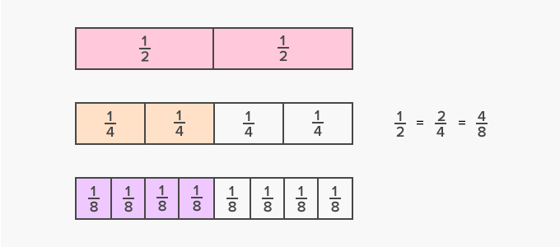
Equivalent fractions
Definition: Different fractions that name the same number.
The shaded boxes are just parts of same part of the whole group.
one half is equal to two fourths, which is also equal to four-eighths

Slide 4
Making Equivalent Fractions
Divide the top and bottom by the same number to get an equivalent fraction.
Multiply the top and bottom by the same number to get an equivalent fraction.
10 ÷ 2 = 5 10 × 3 = 30
12 ÷ 2 = 6 12 × 3 = 36

Slide 5
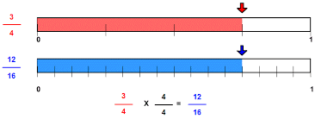
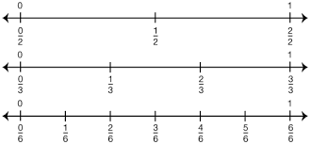
Equivalent Fractions on a Number Line

Slide 6
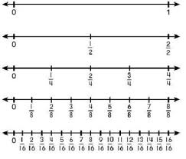
Equivalent Fractions on a Number Line
Pick out the equivalent fractions on these number lines.

Slide 7
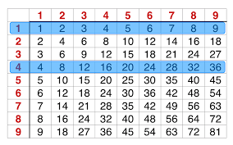
Use a multiplication chart to find equivalent fractions.
Find the numbers you want to use.
Stack them on one another. Each set of numbers is an equivalent fraction.

Slide 8
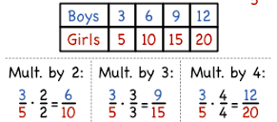
Using Tables for Equivalent Ratios
12 30 60

Slide 9
Practice

Slide 10
Assessment
Write three fractions that are equivalent to each fraction.
⅔
¾
18/20
6/27
50/100
Notes:
Have students compare answers with a shoulder partner. If answers are not all the same ask students if they are both correct and why?

Slide 11
Game time!
Let’s play some Fish Lake!
In Fish Lake, you will practice your fractions by fishing.
You will practice identifying fraction values using a number line.
You will also get to learn some Native American history.

Slide 12
Comparing fractions
To be able to compare fraction you will need to use your knowledge of equivalent fractions to create fractions with common denominators (the same denominator) so that you can compare. You also can use the number line method.

Slide 13
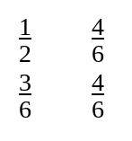
Comparing fractions
4/6 is bigger because it is further to the right on the number line.
Or you can find a common denominator and see which one has more parts.

Slide 14
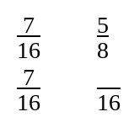
Comparing fractions on a number line
Try both methods

Slide 15
On your own

Slide 16
Game time
Use Fish Lake to practice your math skills.

